Slide 1

Medical Symptoms Classification
Clustering methods in EDA

Slide 2


Background and Motivation
In today's world, there is a significant shortage of family doctors. As a result, many family doctors are overworked and burdened by diagnosing minor and common illnesses, such as coughs or stomach aches.
This overload can lead to fatigue, increasing the risk of misdiagnoses and incorrect treatments.

Slide 3


Imagine a preliminary assessment conducted over the phone,
or even better, an AI-powered machine that classifies symptoms based on the patient's self-reported feelings.
This could free up family doctors to focus on more serious conditions,
improving healthcare outcomes for everyone.

Slide 4
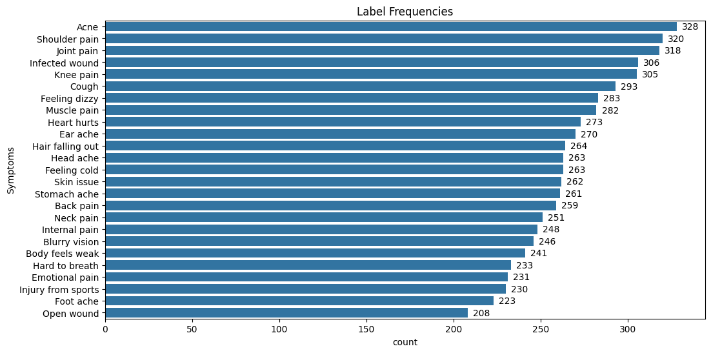
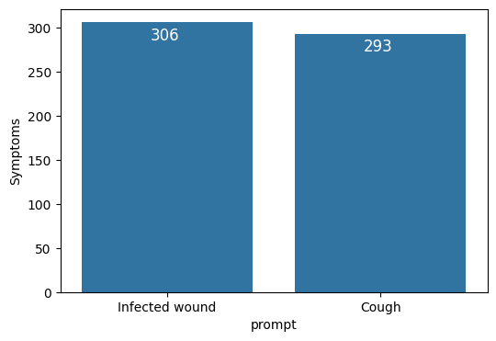
The Data
In order to create such a machine, we need a dataset containing audio files of patients' self-reported problems, each labeled with the corresponding symptom.
And we have just that! Our dataset includes 6661 audio files of patients explaining their problems, classified into 25 different medical symptoms.
We would use the observations labeled “Cough” to represent the minor illnesses and “Infected wound” to represent the major illnesses and we subset 599 observations.

Slide 5
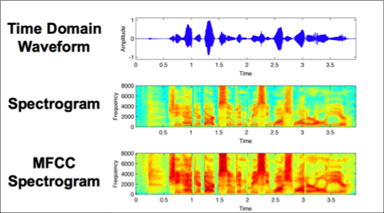
The Data
In addition to the audio files themselves, there are 4 audio quality scores.
From the audio files, I’ve extracted the duration, 13 means and standard deviations of MFCCs across the signals, mean and std of the spectral centroid, mean and std of the zero-crossing rate, mean and std of the rms of the audio.
In total, There are 37 continuous features.
Notes:
MFCC – Taking the waveform (Amplitude over time) and windowing, applying Fourier transform, changing the data to Mel-scale, taking the logarithm and applying another Fourier transformation.
Spectral Centroid – Taking each window of the waveform and normalizing the aplitude, then taking the mean over the frequencies (Hz). centroid[t] = sum_k S[k, t] * freq[k] / (sum_j S[j, t]), where S is a magnitude spectrogram, and freq is the array of frequencies (e.g., FFT frequencies in Hz) of the rows of S.
Zero Crossing Rate - is the rate at which a signal changes from positive to zero to negative or from negative to zero to positive.
RMS - Compute root-mean-square (RMS) value for each frame in the spectrogram.

Slide 6
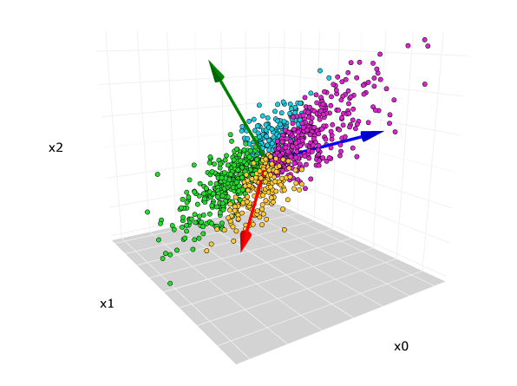
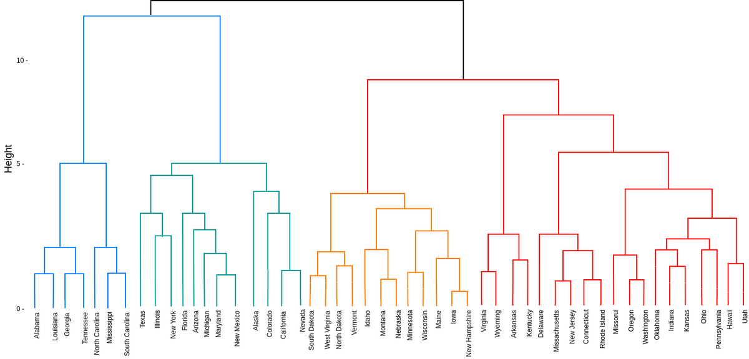
Visualization of High-Dimensional Data
In order to visualize the clusters, I will use Principal Components Analysis (PCA) and t-distributed Stochastic Neighbor Embedding (t-sne).
Dendrograms also will be used to visualize the hierarchical clustering methods

Slide 7
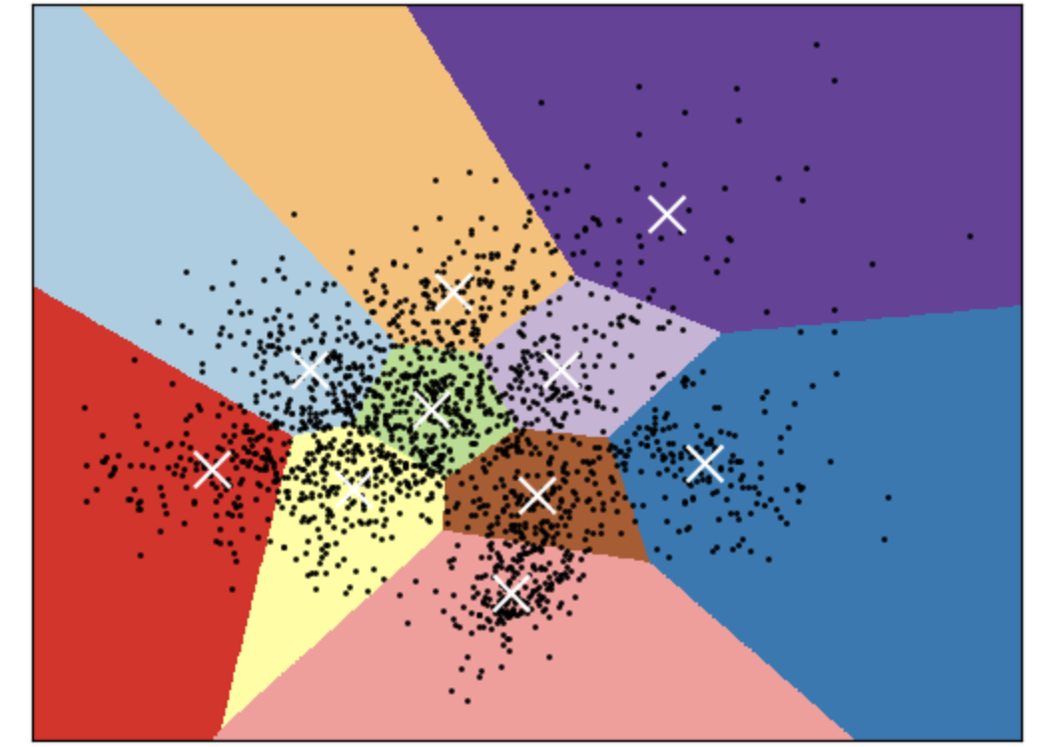
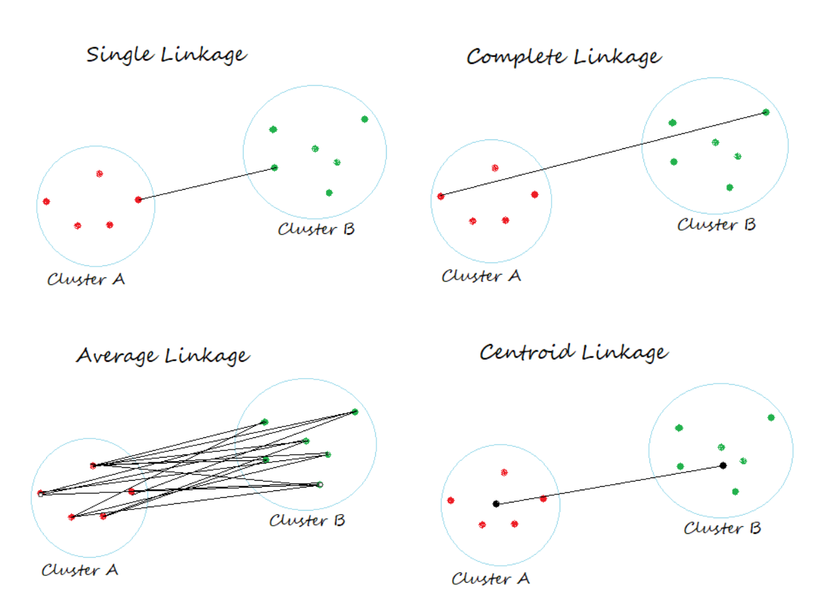
Clustering Methods
The clustering methods will be used are:
K-means
Gaussian Mixture Models (GMM)
Hierarchical Clustering using the following linkages:
Complete
Single
Average

Slide 8
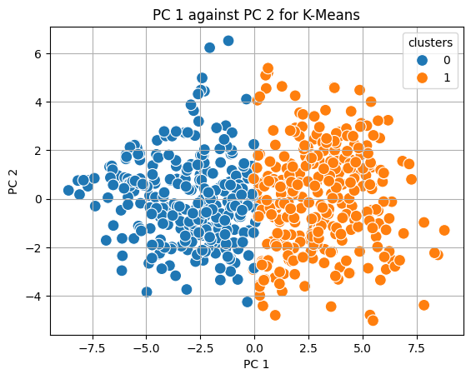
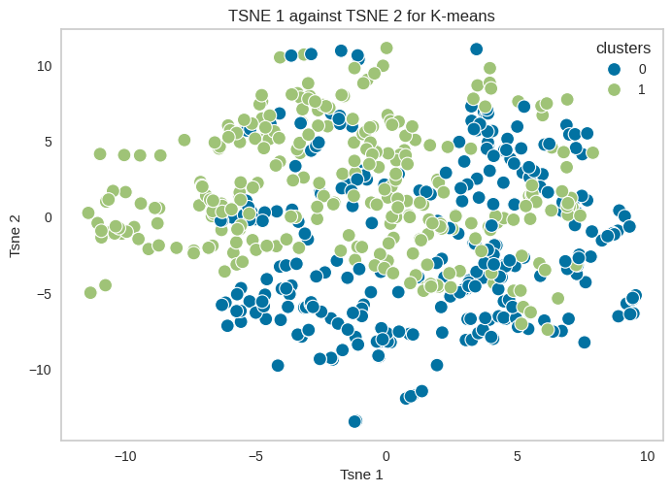
K-Means
Randomly assign a number, from 1 to K to each of the observations. These serves as initial cluster assignments for the observations.
Iterate until the cluster assignments stop changing:
For each of the K clusters, compute the cluster Centroid. The k-th cluster centroid is the vector of p feature means for the observations in the k-th cluster.
Assign each observation to the cluster whose centroid is the closest by the Euclidean distance.

Slide 9
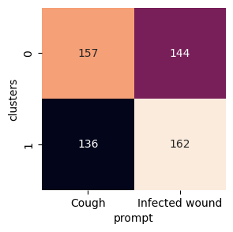
K-Means

Slide 10
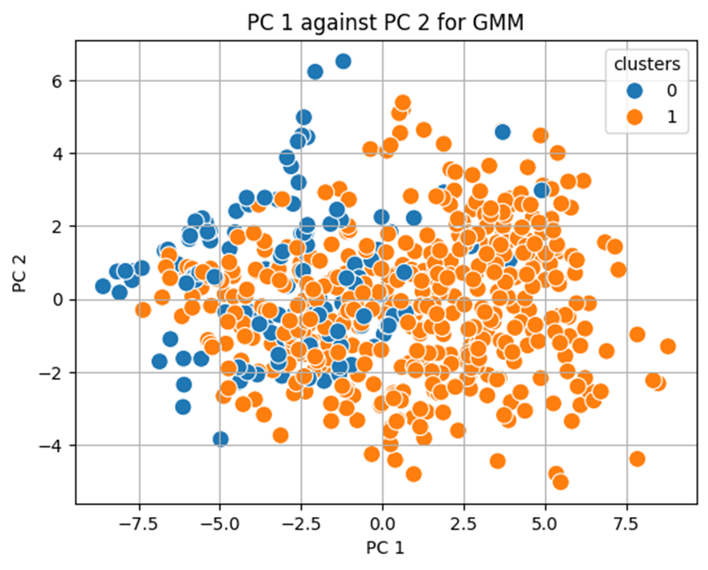
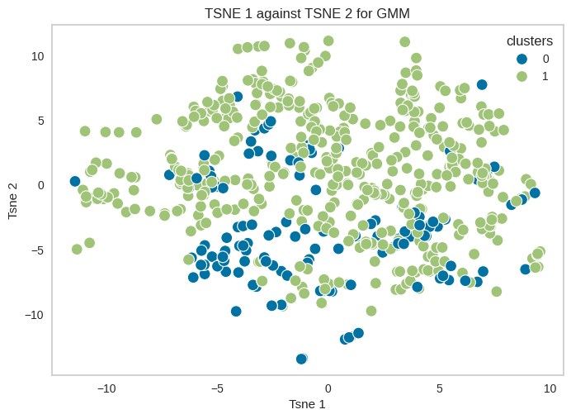
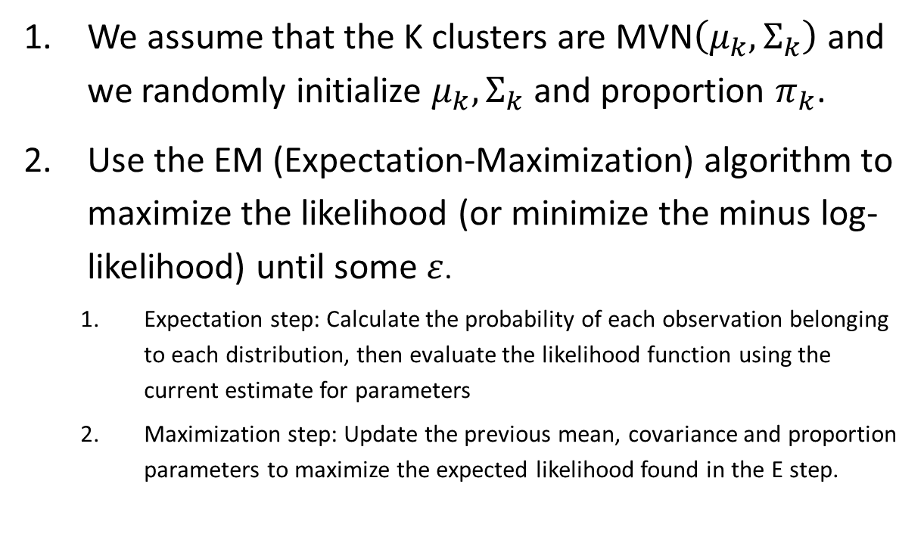
Gaussian Mixture Model (GMM)
We assume that the K clusters are MVN$\left(μ_{k},Σ_{k}\right)$ and we randomly initialize $μ_{k}, Σ_{k}$ and proportion $π_{k}$.
Use the EM (Expectation-Maximization) algorithm to maximize the likelihood (or minimize the minus log-likelihood) until some $ε$.
Expectation step: Calculate the probability of each observation belonging to each distribution, then evaluate the likelihood function using the current estimate for parameters
Maximization step: Update the previous mean, covariance and proportion parameters to maximize the expected likelihood found in the E step.

Slide 11
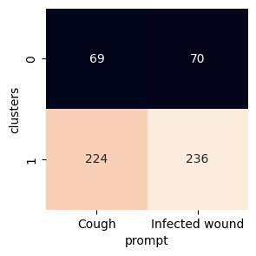
Gaussian Mixture Model (GMM)

Slide 12
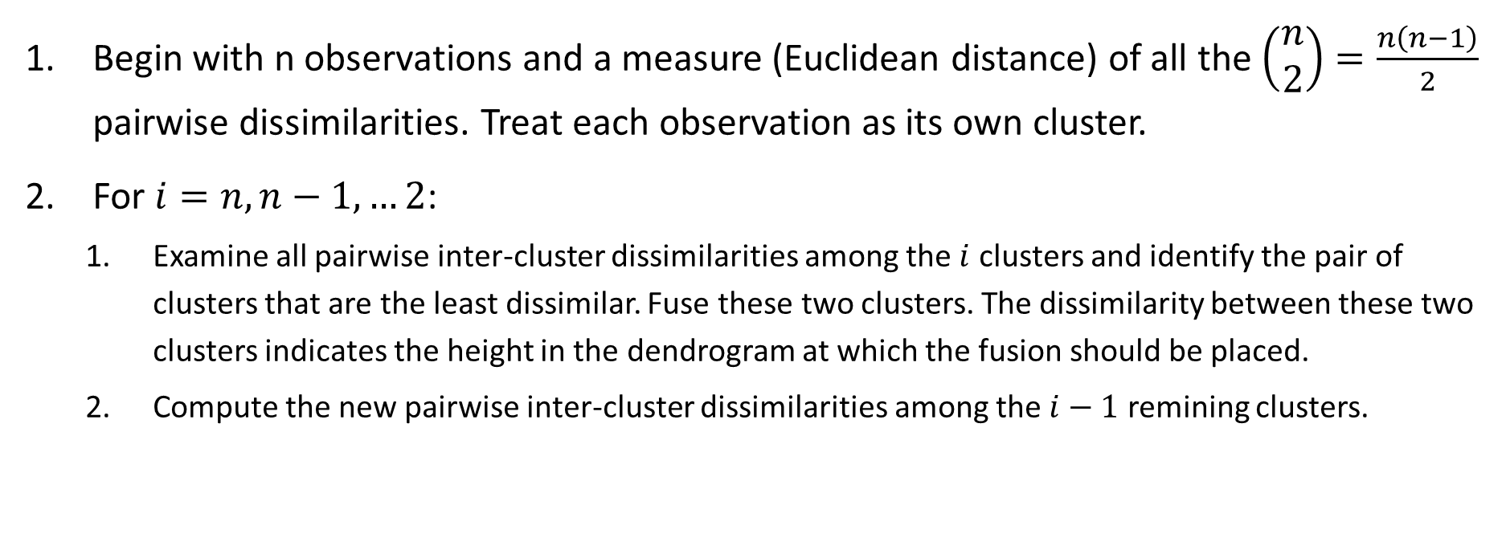
Hierarchical Clustering
Begin with n observations and a measure (Euclidean distance) of all the $\left(\begin{matrix}n \\ 2\end{matrix}\right)=\frac{n\left(n−1\right)}{2}$ pairwise dissimilarities. Treat each observation as its own cluster.
For $i=n,n−1,…2$:
Examine all pairwise inter-cluster dissimilarities among the $i$ clusters and identify the pair of clusters that are the least dissimilar. Fuse these two clusters. The dissimilarity between these two clusters indicates the height in the dendrogram at which the fusion should be placed.
Compute the new pairwise inter-cluster dissimilarities among the $i−1$ remining clusters.

Slide 13
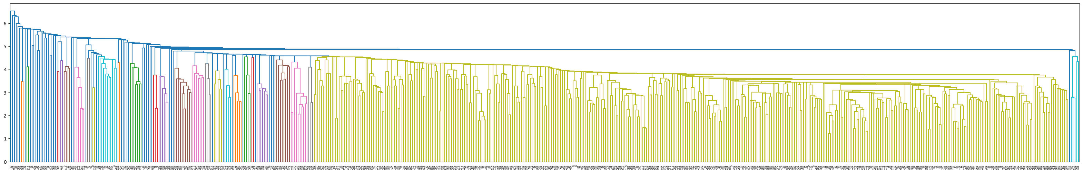
Hierarchical Clustering – Single Linkage

Slide 14
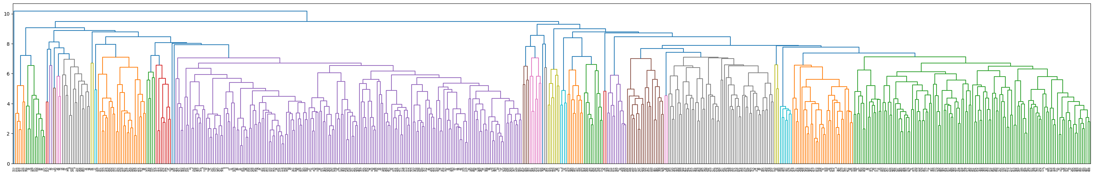
Hierarchical Clustering – Average Linkage
Cluster 0: only observation 553 Cluster 1: the rest of the observations

Slide 15
Observation 553
This observation is assigned in all methods of clustering into cluster 1 and have extremely high MFCC values in all observations in the cluster.
I will drop this observation and discuss the clusters assigned from the hierarchical clustering methods.

Slide 16
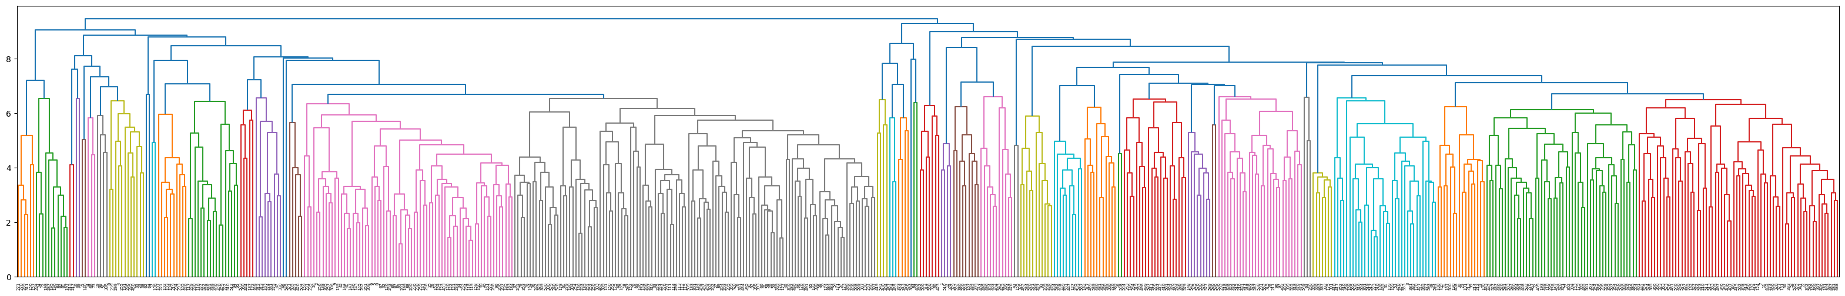
Hierarchical Clustering – Average Linkage without observation 553
Cluster 0
Cluster 1

Slide 17
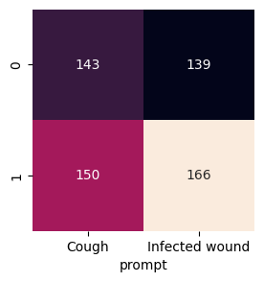
Hierarchical Clustering – Average Linkage without observation 553

Slide 18
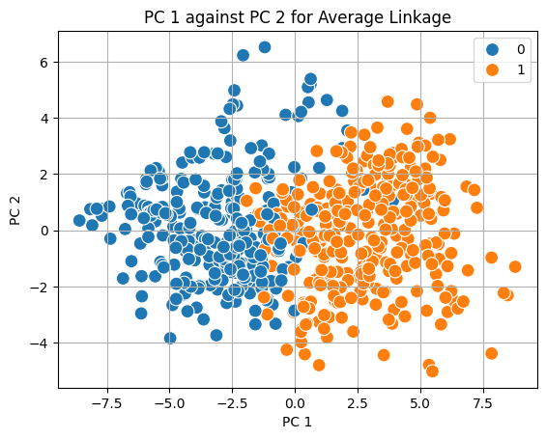
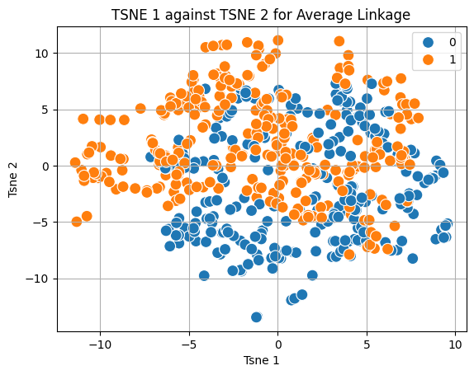
Hierarchical Clustering – Average Linkage without observation 553

Slide 19
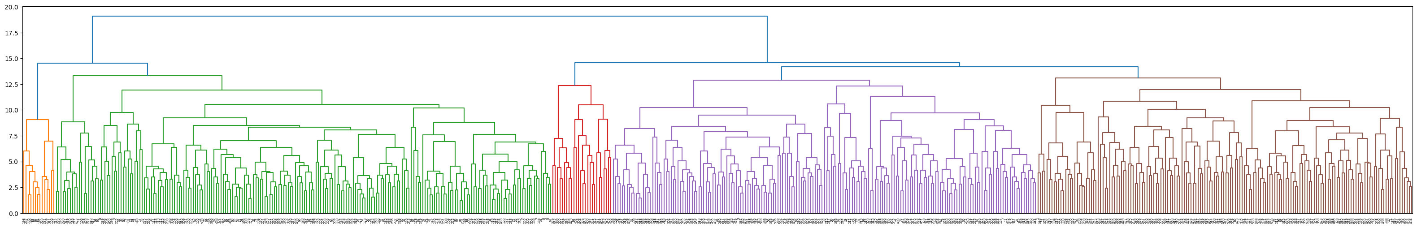
Hierarchical Clustering – Complete Linkage
Cluster 0
Cluster 1

Slide 20
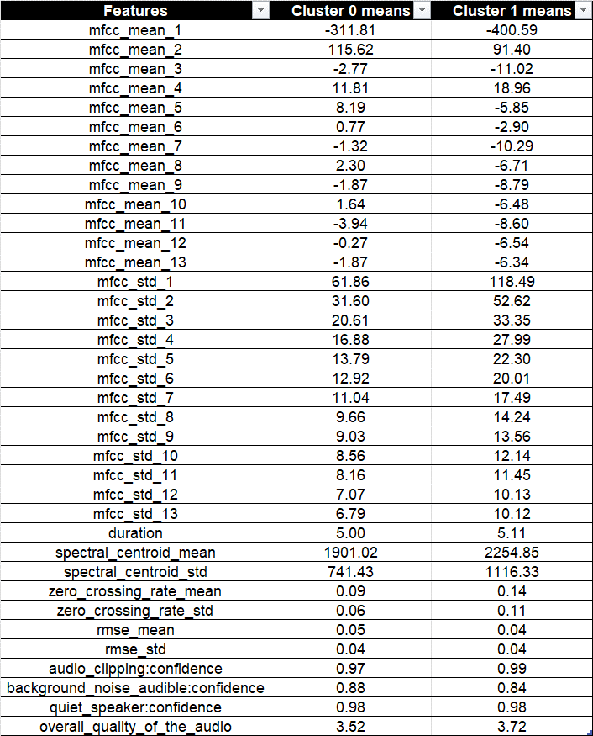
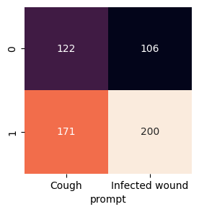
Hierarchical Clustering – Complete Linkage without observation 553

Slide 21
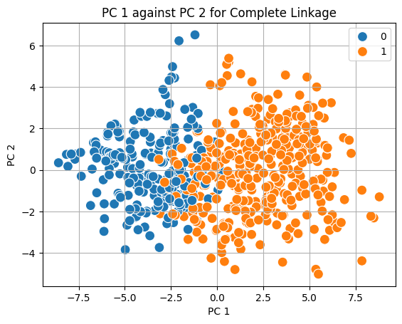
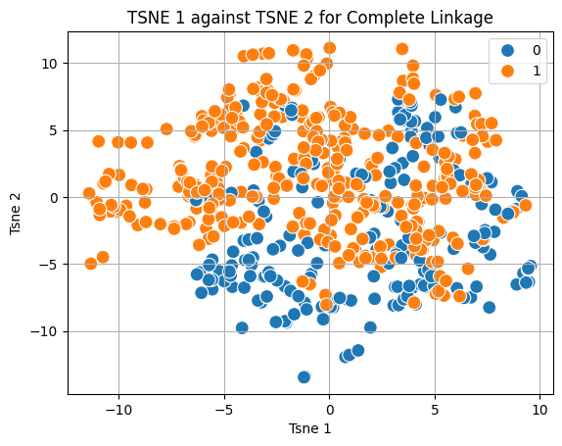
Hierarchical Clustering – Complete Linkage without observation 553

